Slide 1

MLS Penalty Outcome Analysis (2008-2022)
By Marcos Herrero Bellido

Slide 2

Introduction
This senior research project illustrates how my experience at Knox has been profoundly shaped by my participation on the Men’s Soccer team. In addition to the knowledge I gained in class, I also learned many valuable lessons from being part of this team.
Throughout this research I explored various datasets about the MLS. Ultimately, I found these MLS datasets in Kaggle:

Slide 3

Dataset Description:
From the matches.csv:
ID column to uniquely identify each match, along more useful information like home and away team names, competition, time, date and year
From the events.csv:
ID column to uniquely identify each match, an event column that stores a description of the event along with another column Time to record the minute of the event

Slide 4

Dataset Description
How to identify penalty events?
How to determine the outcome of a penalty?
What team took the penalty?
Which player starred the penalty?
And goalkeeper?

Slide 5
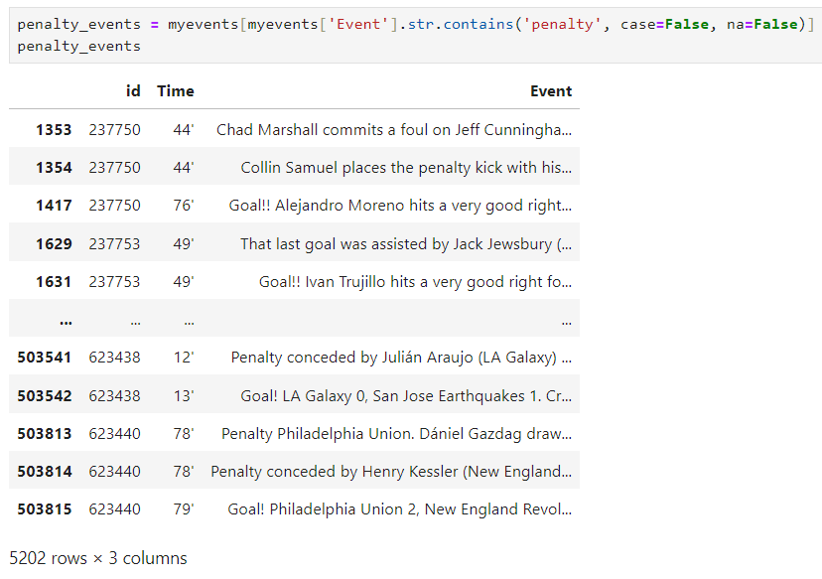
Finding penalty events

Slide 6
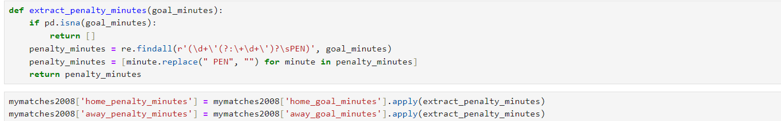
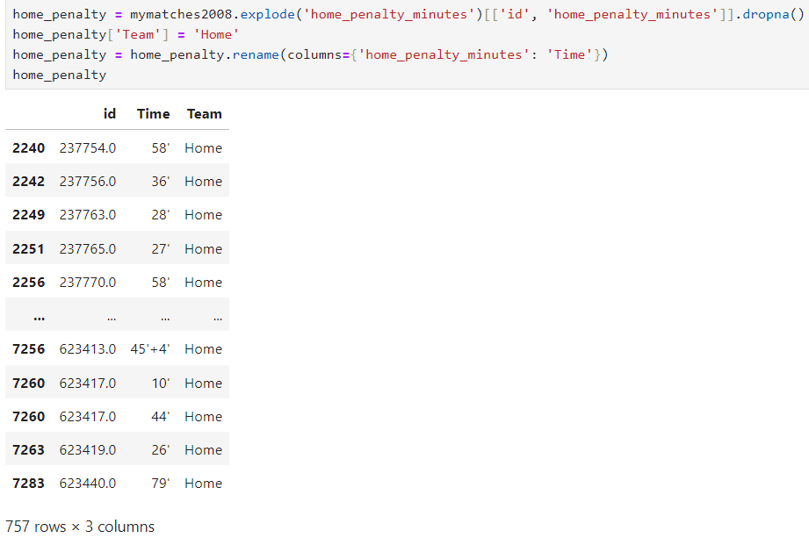
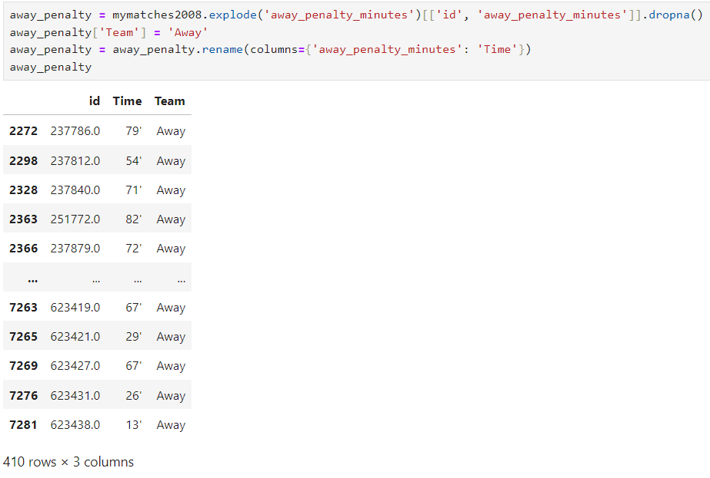
Classifying penalties scored

Slide 7
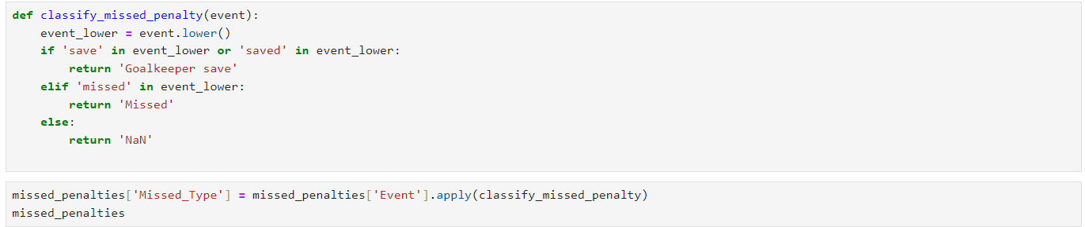
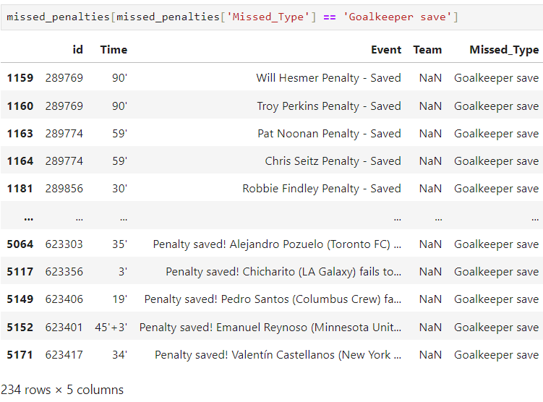
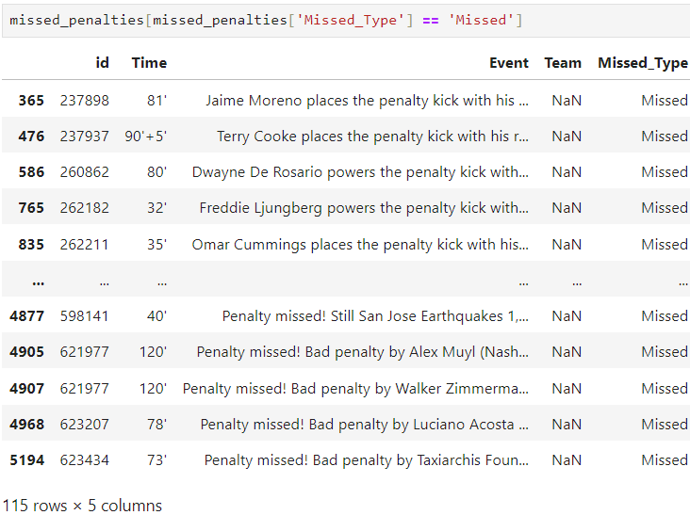
Classifying penalties not scored

Slide 8
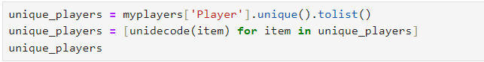
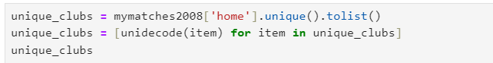
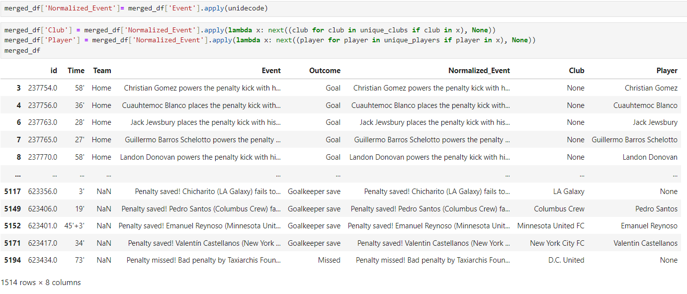
Finding the player that starred the penalty

Slide 9
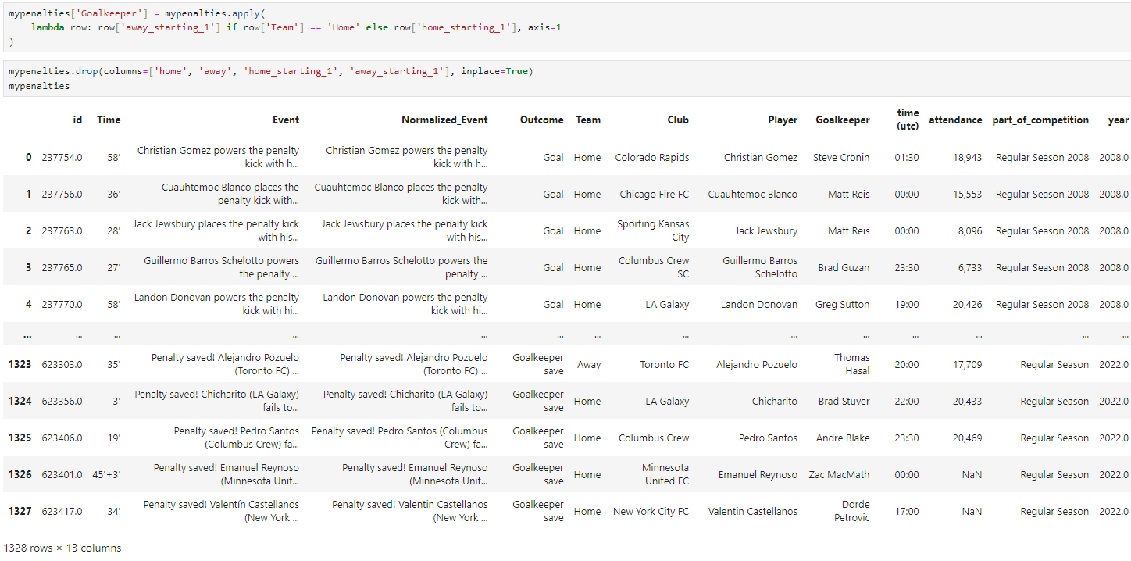
Finding the goalkeeper that faced penalty

Slide 10
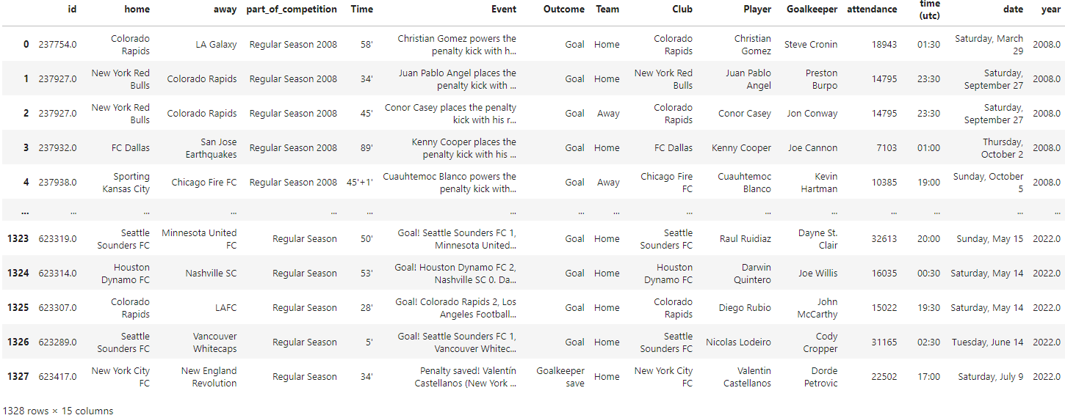
Final penalty events dataset

Slide 11
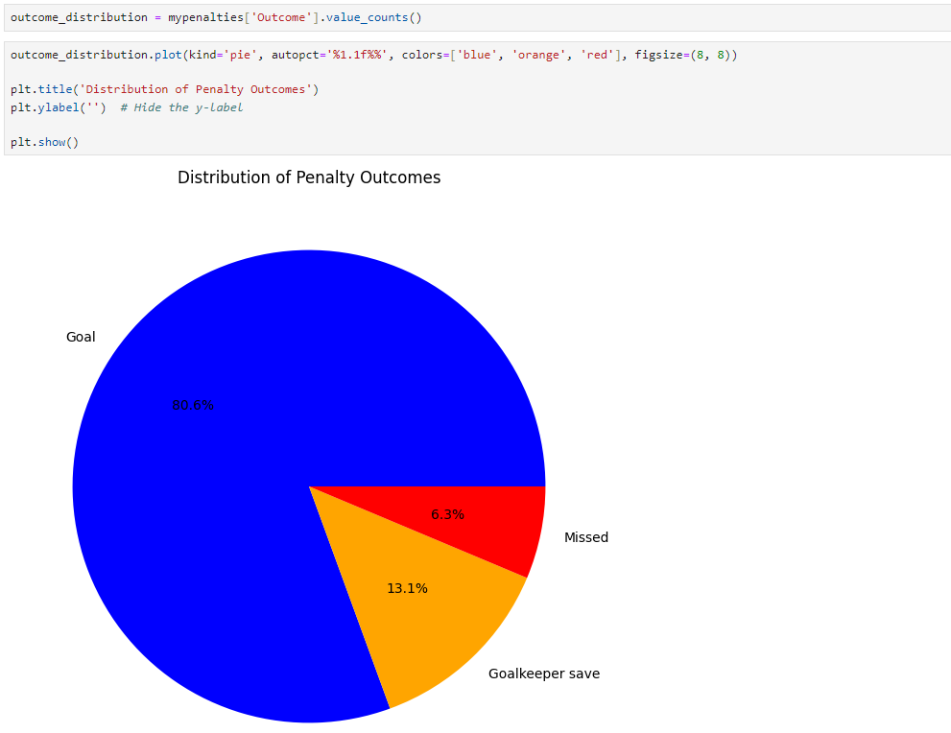

Slide 12
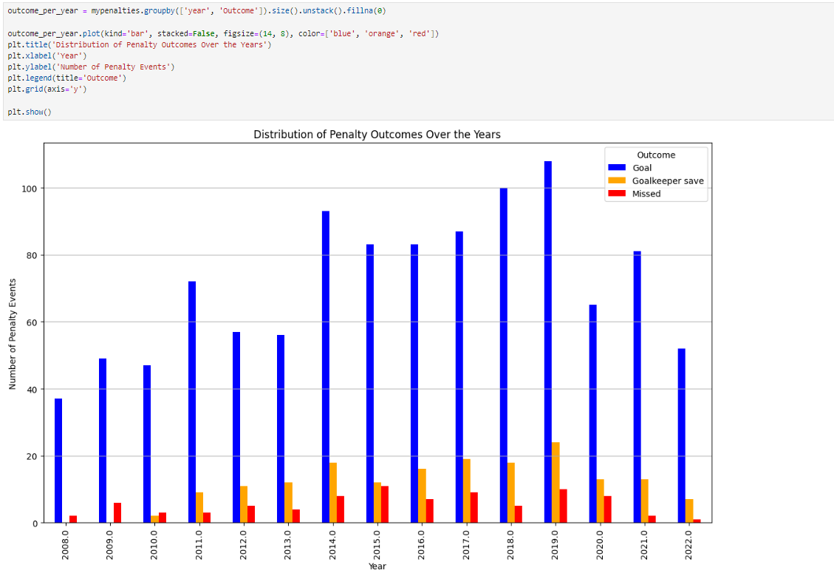

Slide 13
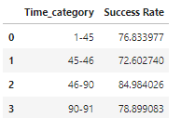
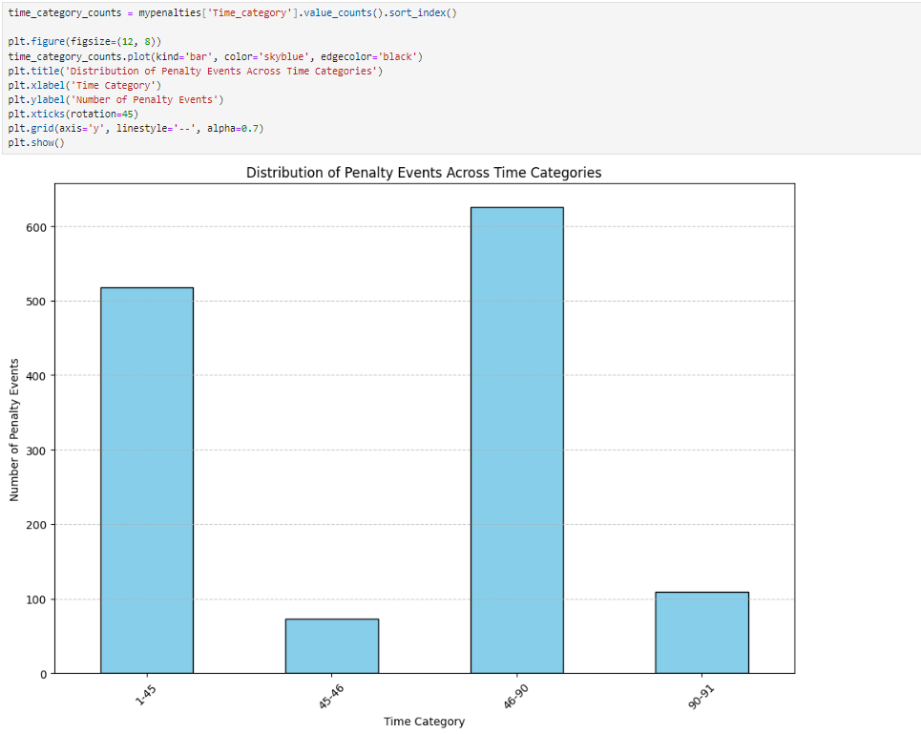
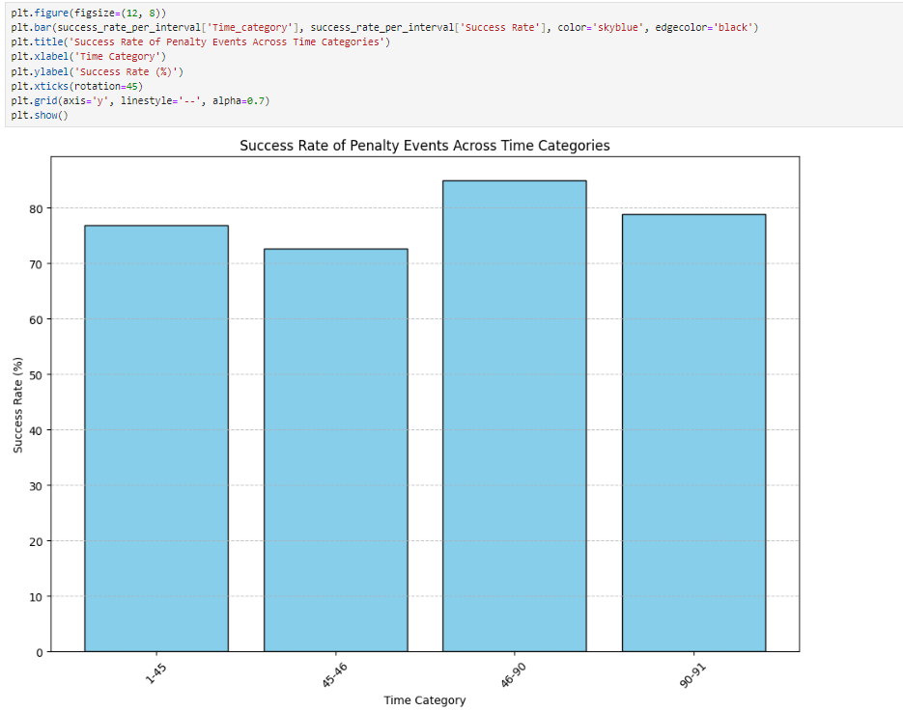
Penalty distribution over a 90min match

Slide 14
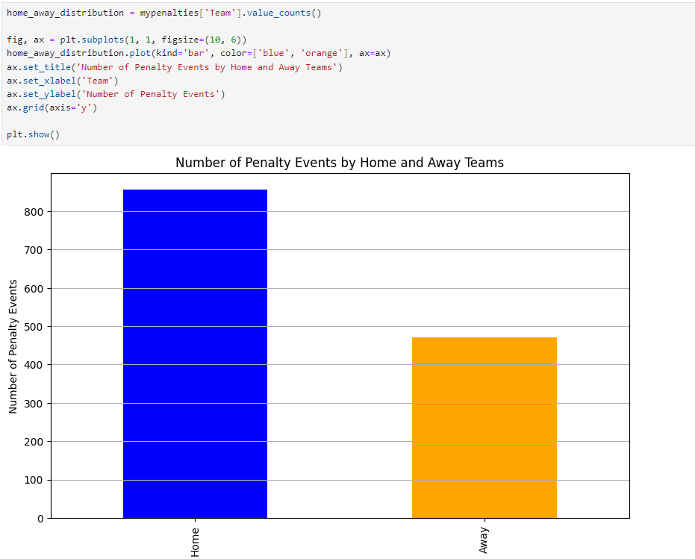
Home vs Away penalty events

Slide 15
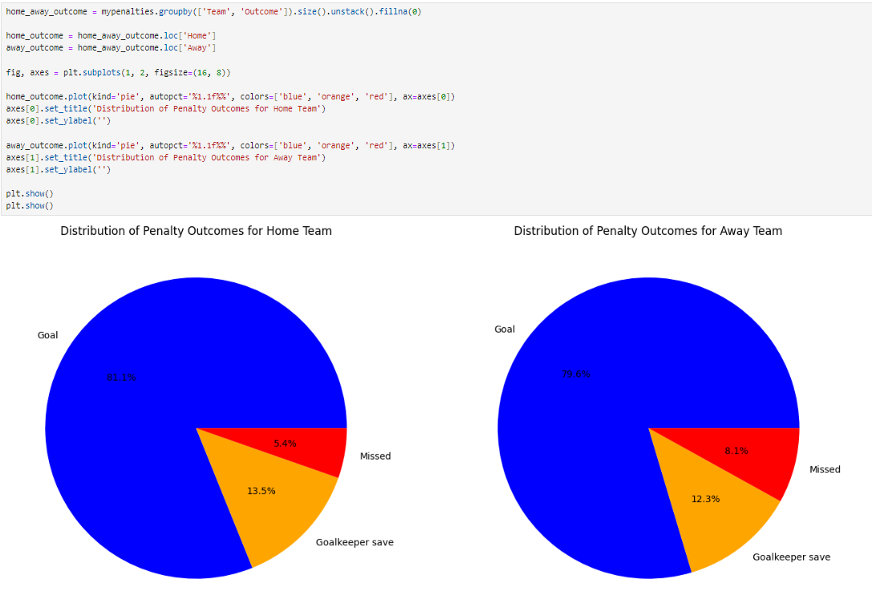

Slide 16
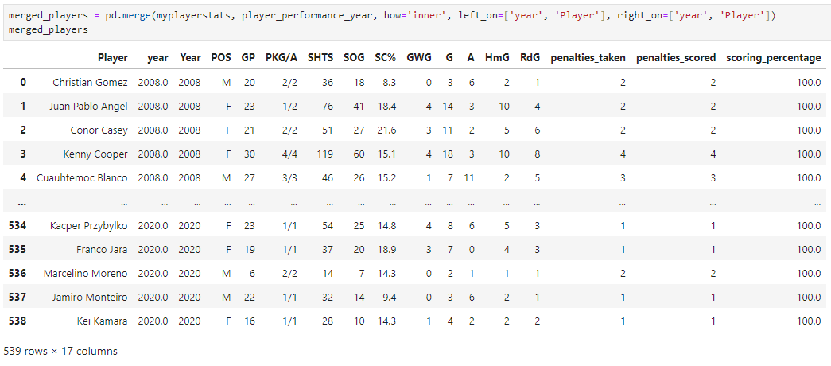
Player Performance

Slide 17
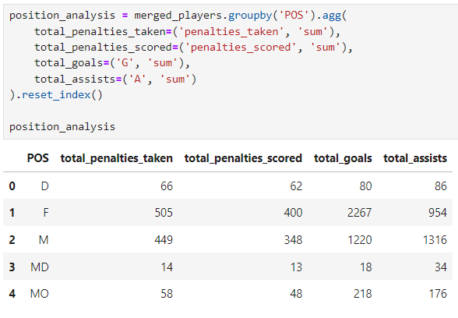
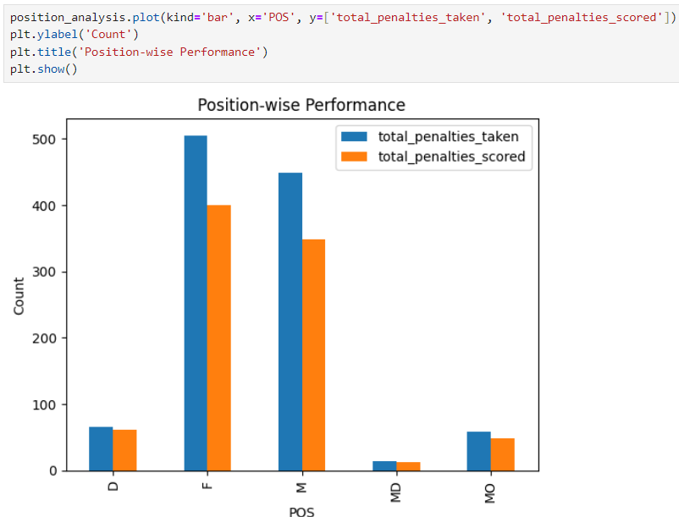
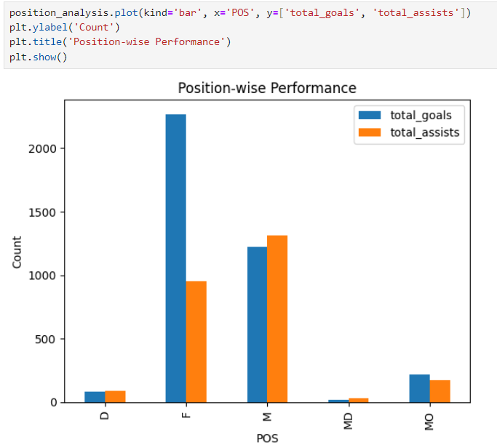
Player Performance by positions

Slide 18
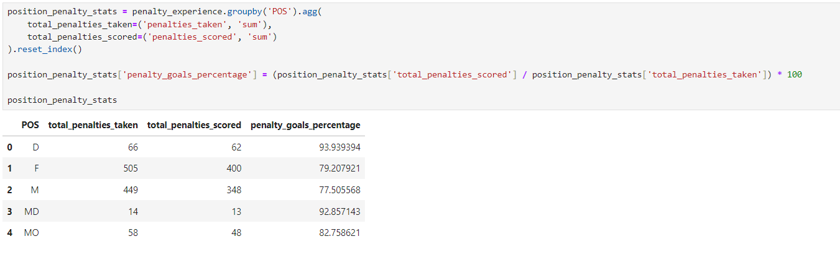
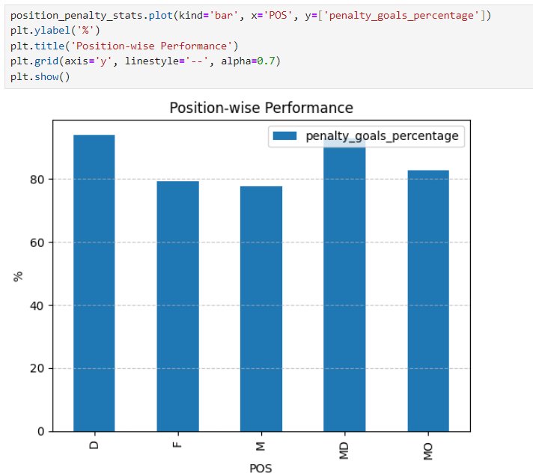

Slide 19
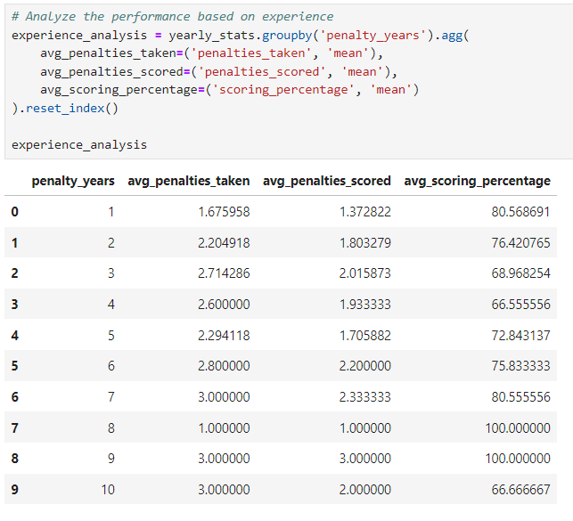
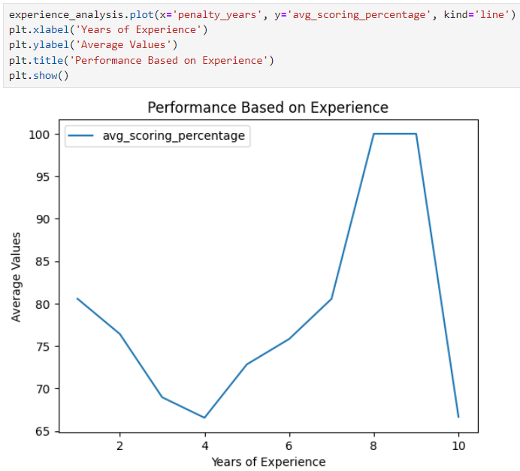
Player Experience

Slide 20
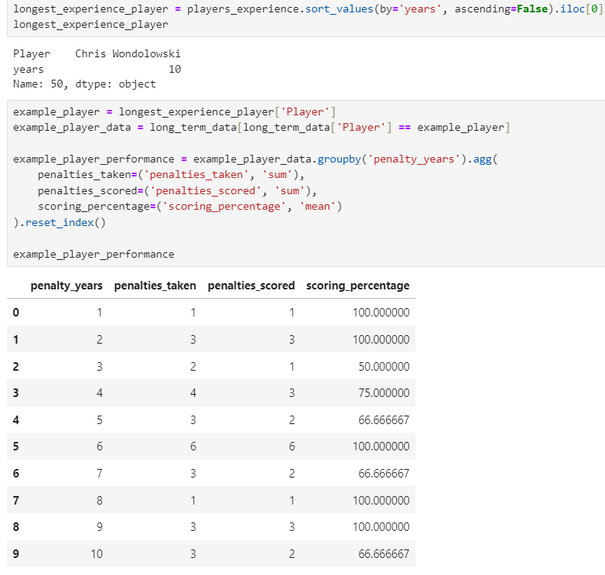
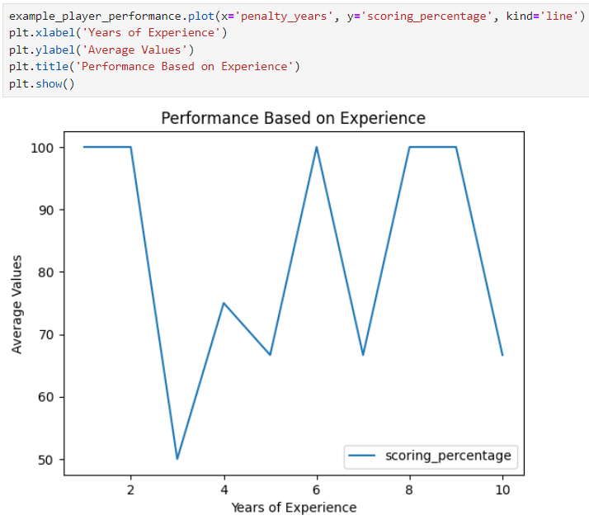
Player Performance: Chris Wondolowski

Slide 21
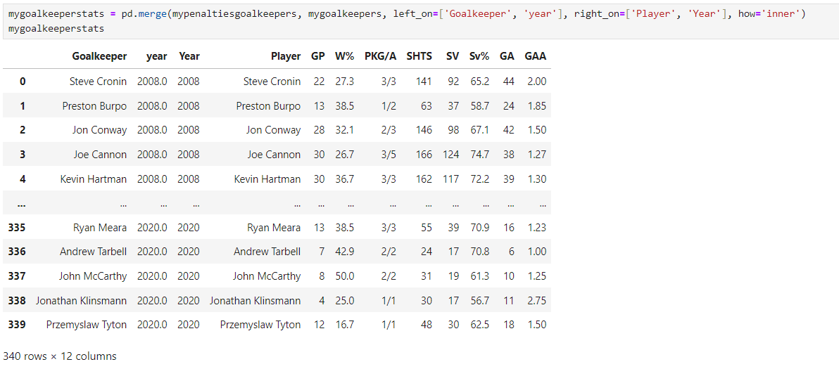
Goalkeeper Performance

Slide 22
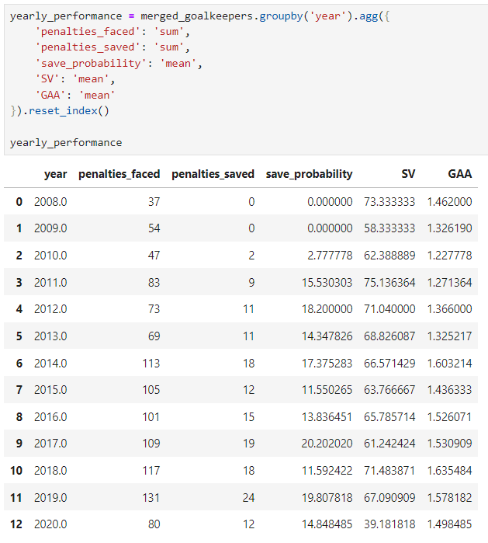
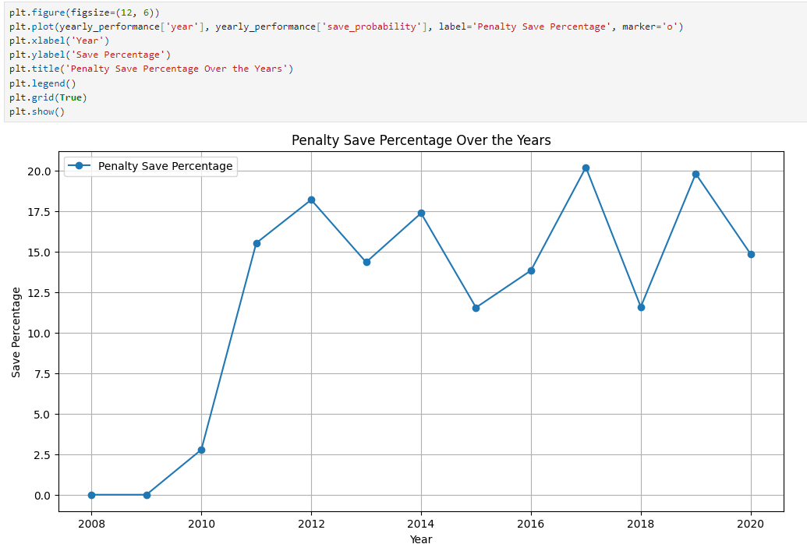

Slide 23
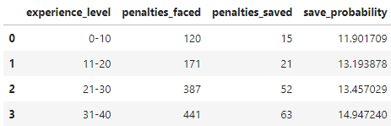
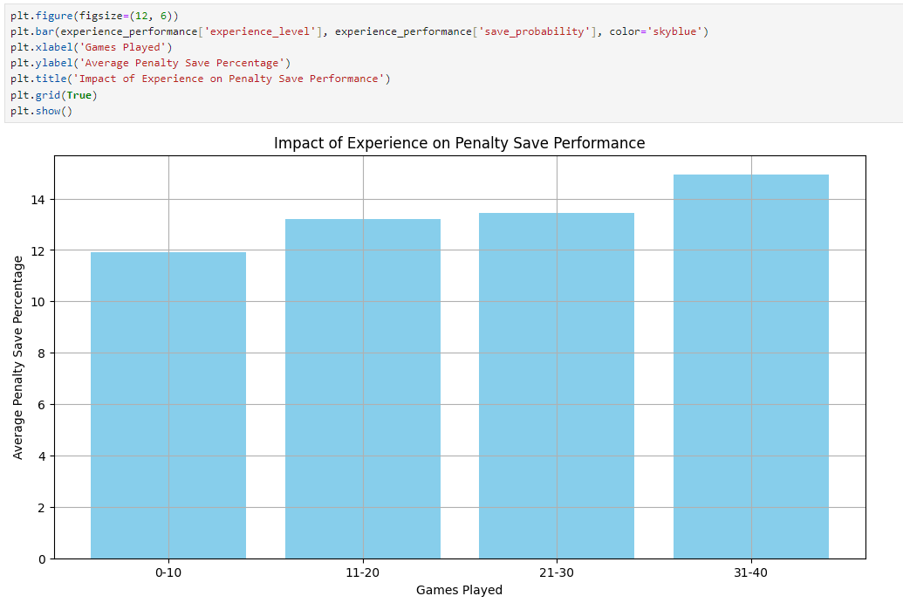
Goalkeeper Experience

Slide 24
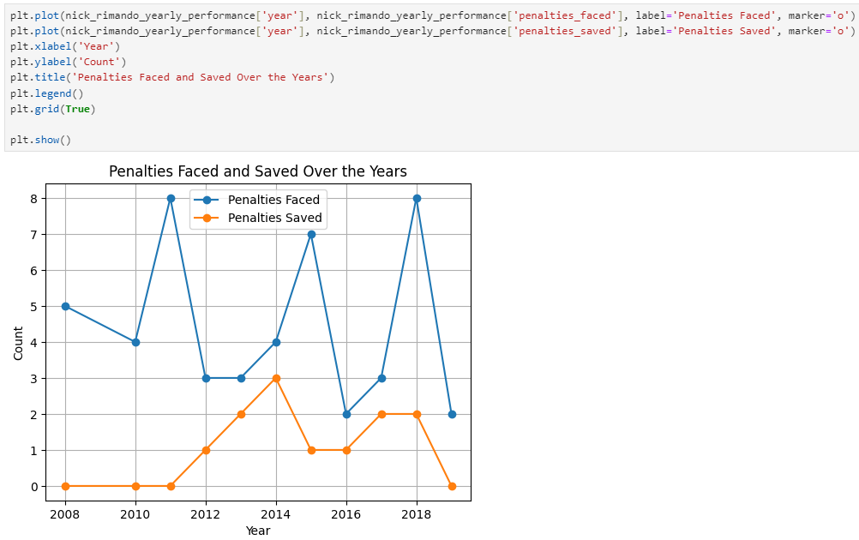
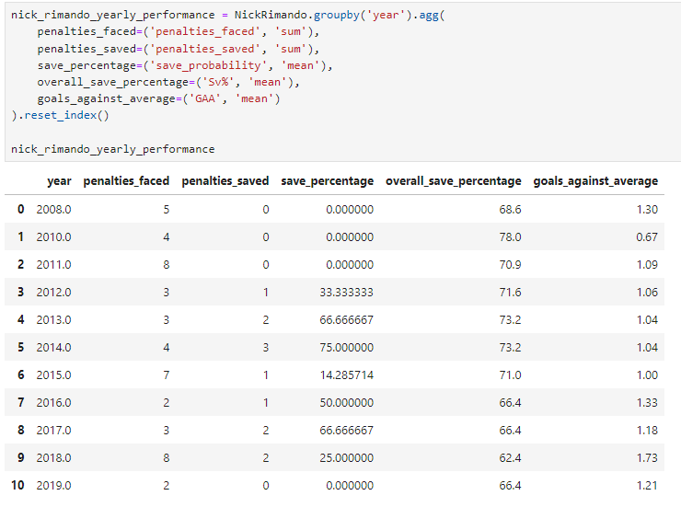
Goalkeeper Performance: Nick Rimando

Slide 25
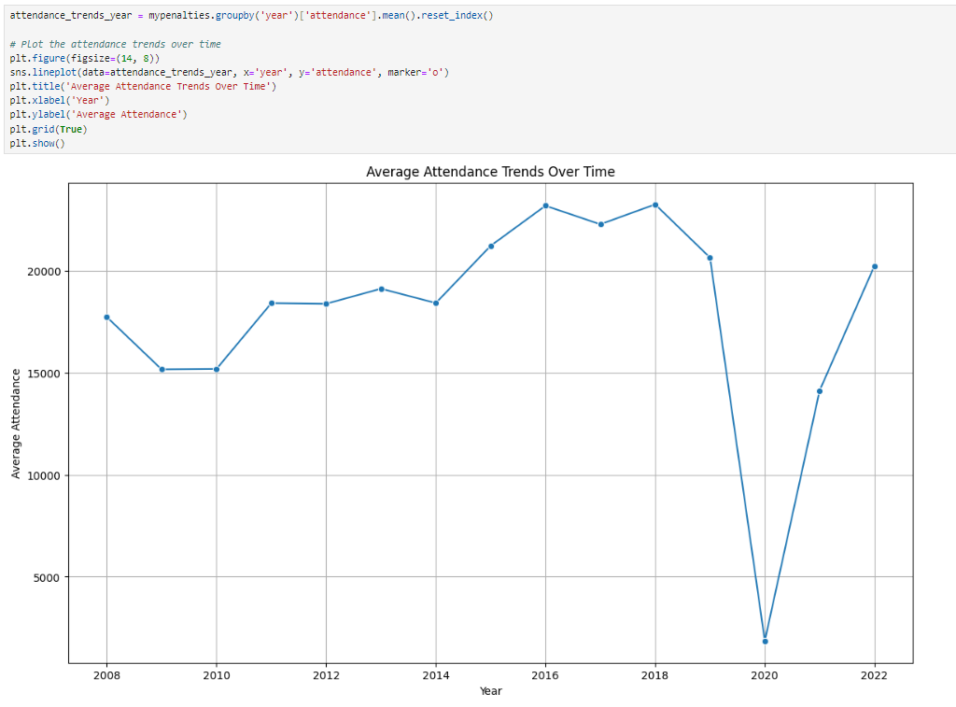
Attendance

Slide 26
Conclusion
Throughout this analysis, we observed consistent positive trends, reflecting the evident growth of soccer in the United States in recent years.
After carefully examining the parameters in the dataset, we identified a crucial factor whether your team is playing at home or away significantly influences penalty outcomes
However we cannot overlook the impact of player and goalkeeper performance, experience plays a pivotal role in the outcome of these events

